Slide 1

European Soccer Analysis
Team Number: 25
Team Members:
Akshita Barot
Gauri Patole

Slide 2

Contents:
Introduction
Data Wrangling
Exploratory Data Analysis
Feature Engineering
Data Modeling
Model Evaluation
Conclusion

Slide 3




Background, Motivation and Goal

Slide 4
Background:
The UEFA (Union of European Football Associations) Champions League often known as European Soccer League, is a continental football competition that attracts the best soccer teams from across Europe.
Motivation:
The European soccer dataset analysis provides valuable information on matches, teams, and players from several European leagues, allowing researchers and enthusiasts to gain deeper insights into the game.
Through data analysis, teams and analysts can use the European soccer dataset to make strategic decisions and gain a competitive advantage in the sport.
Goal:
We want to create a football prediction model, this model will determine the outcome of match (win, lose, draw).

Slide 5

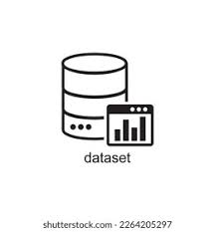
Database consists information of 25000+ matches and 10000+ players recording from seasons 2008 to 2016.
Tables | Rows | Columns
Country | 11 | 2
League | 11 | 3
Match | 25979 | 115
Players | 11060 | 7
Player_Attributes | 183978 | 42
Team | 299 | 5
Team_Attribute | 1458 | 25

Slide 6

Here we are exploring missing values, duplicate values from Match , Team.
Unwanted columns are dropped from Match table.
Creating a new column ‘winner’ in Match table.
Changing datatype of Date column from ‘String’ to ‘DateTime’.

Slide 7


Slide 8
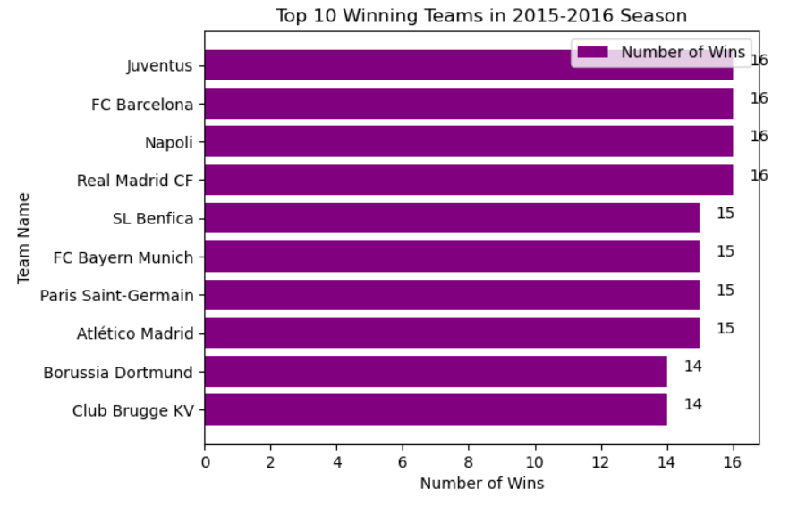

Q1. Which top 10 teams had the most victories at home in 2015/2016 Season?
Extracted the matches that occurred during the period of 2015 to 2016.
Filtered the relevant rows and focused on the ‘home_team_name’ column to identify top 10 teams that have the maximum number of wins on their home turf.

Slide 9


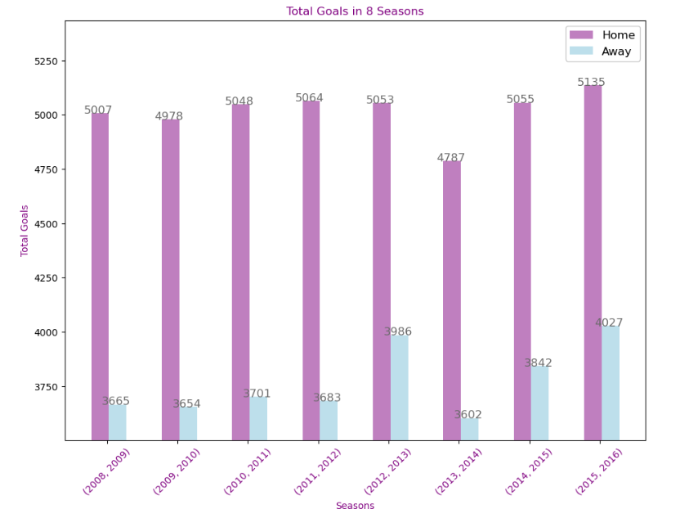
Q2. Which season had the most home and/or away goals over the seasons?
Comparing the home and away goals for each season, and consistently showing that home teams score more goals than away teams.
Notably, the season 2015-2016 had the highest total number of goals scored.

Slide 10
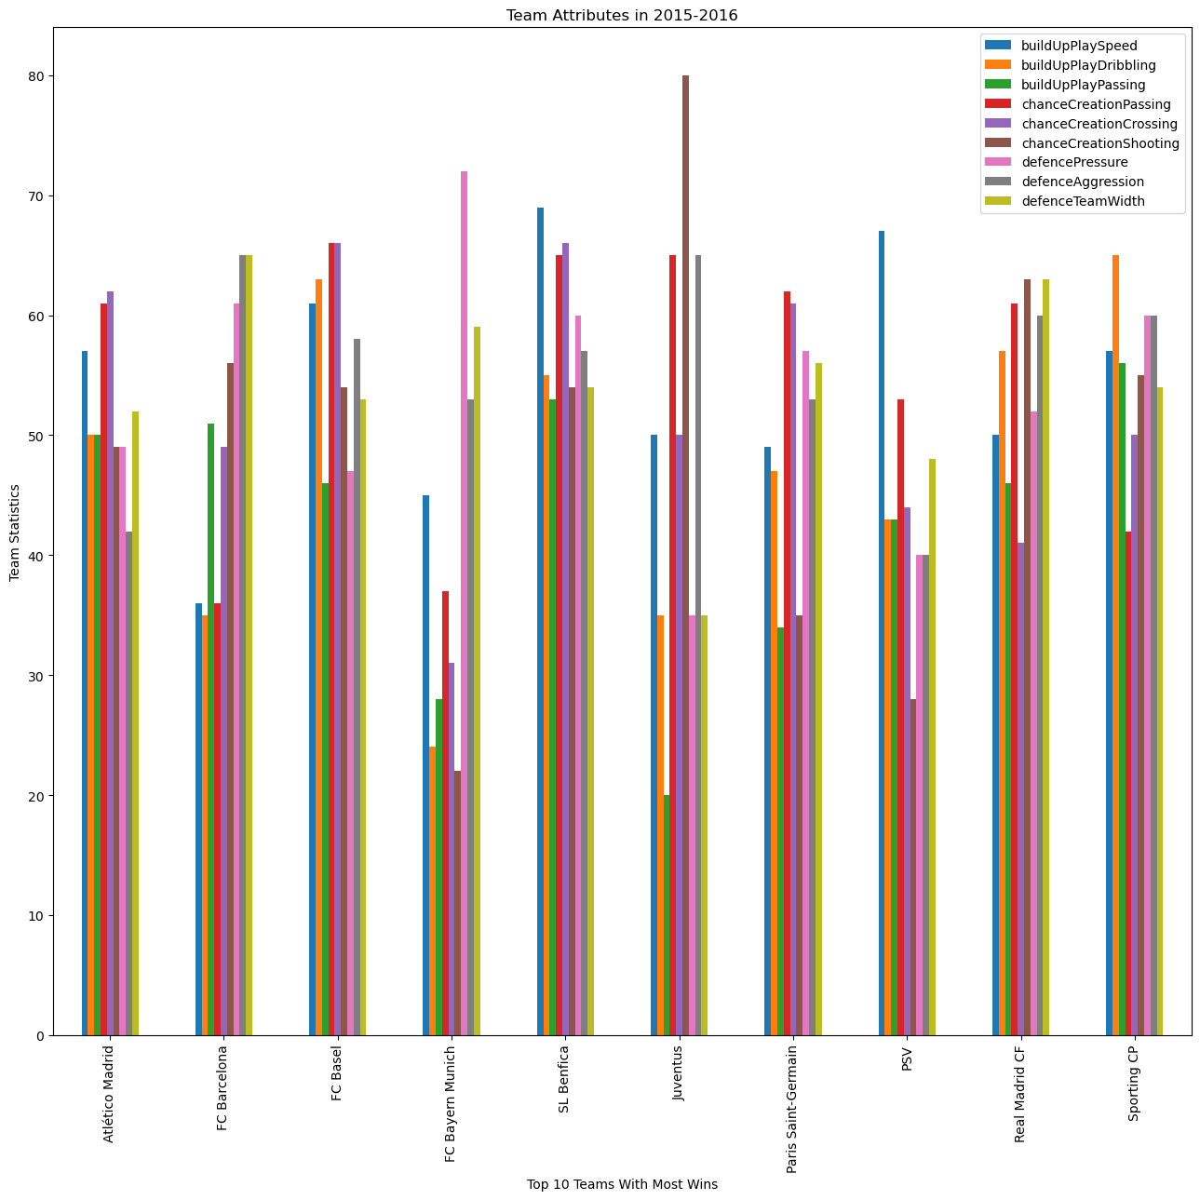
Q3. What Team Attributes leads to a Team's Victory?
The chart below provides attributes of the winning teams. These charts display 9 distinct characteristics for the top 10 winners during the 2015-2016 season.

Slide 11


Slide 12
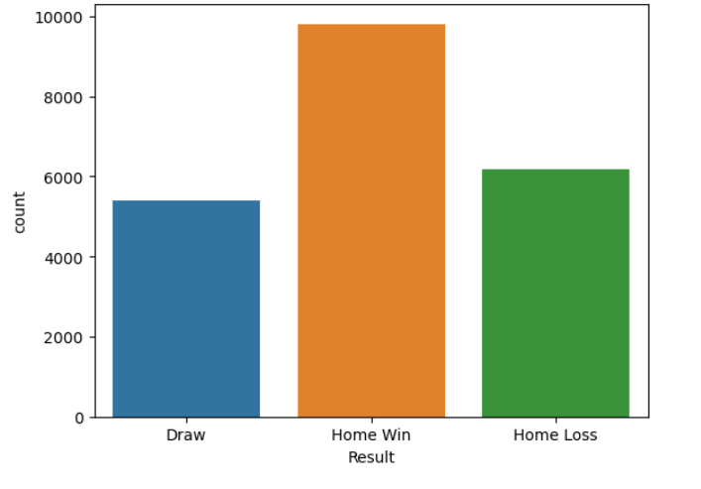
Visualizing our Target Variable: Match Result
We have used count plot of ‘Result’ column which represents the outcomes of soccer matches as an integer. The integers are replaced with strings representing the outcomes, such as ‘Home Win’ using ‘replace’ function.

Slide 13
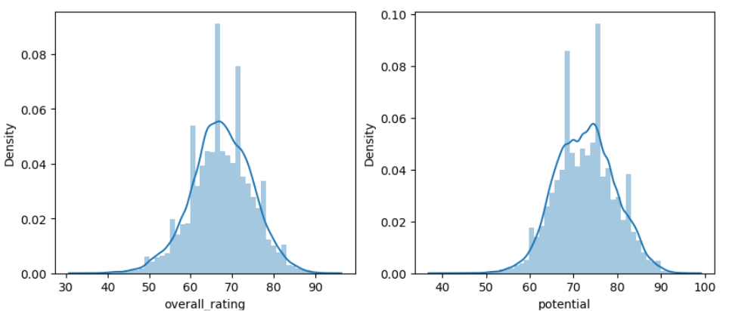
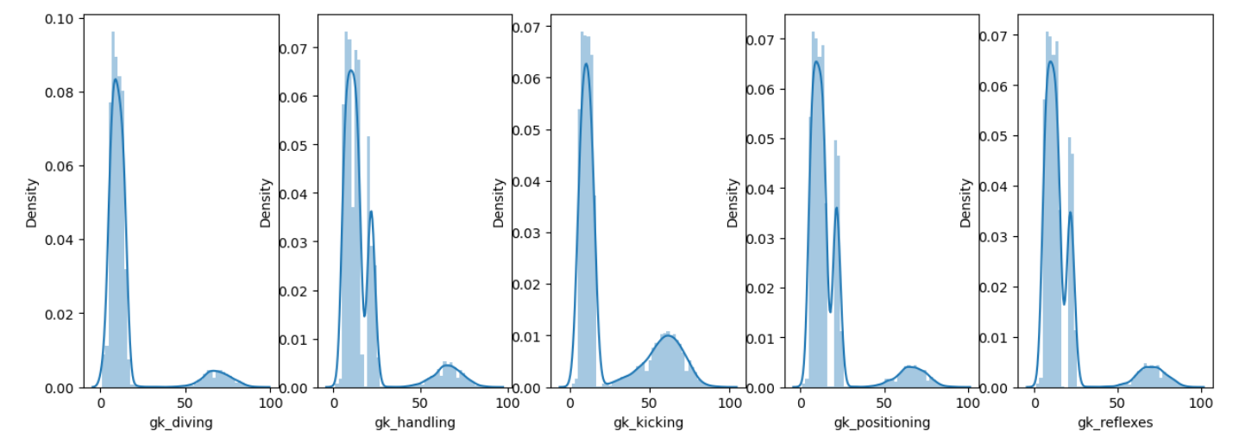
Player Attributes Exploration
Goalkeeper Attributes:

Slide 14
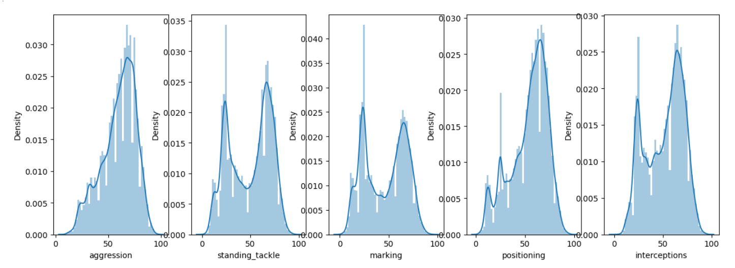
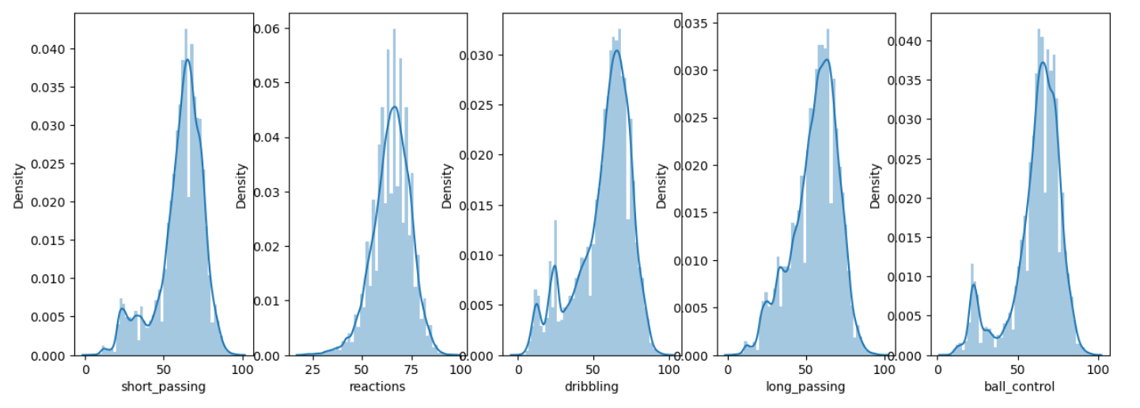
Defensive Attributes:
Midfielder Attributes:

Slide 15


Slide 16
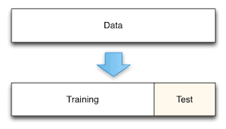
Splitting Training and Test Data
Training data - Matches played between 2008 and 2014.
Test data - Matches played between 2015 and 2016.
Training data shape before dropping the null values: (16848,171)
Test data shape before dropping the null values: (4526,171)
Training data shape after dropping the null values: (15457,171)
Test data shape after dropping the null values: (3978,171)

Slide 17

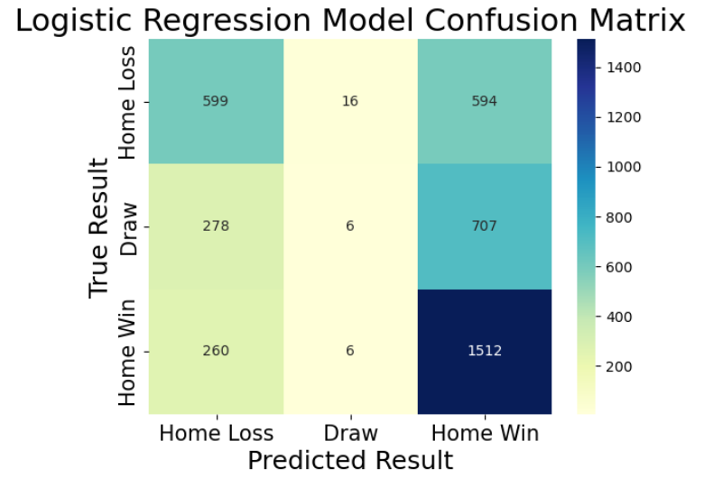
Logistic Regression
Logistic regression is a statistical analysis used to predict the probability of a binary outcome based on one or more predictor variables.
The logistic function is commonly used to represent the probability of a binary outcome as a function of the predictor variables.

Slide 18
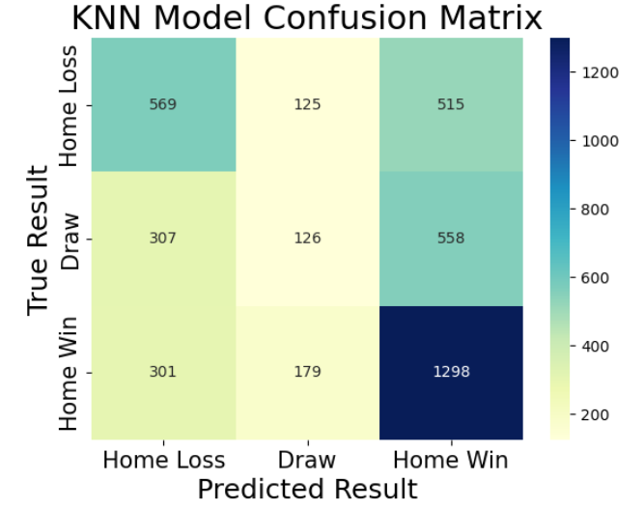
K-Nearest Neighbors
The algorithm works by calculating the distances between the new observation and all the observations in the training set. It then selects the k closest observations and assigns the most common class or average value as the predicted outcome.
KNN is a non-parametric algorithm, meaning it does not make any assumptions about the underlying distribution of the data.

Slide 19
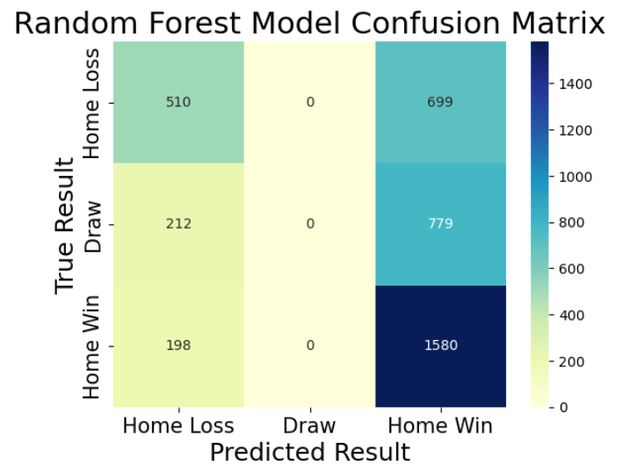
Random Forest
It is an ensemble learning method that combines multiple decision trees to make a final prediction.
Each tree in the forest is built using a random subset of the training data and a random subset of the features.

Slide 20
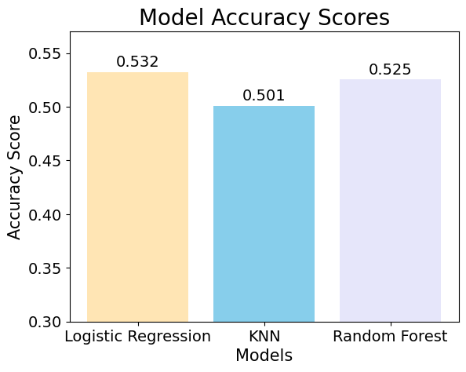
Model Evaluation
Best Logistic regression score : 0.532
Best KNN Score : 0.501
Best random Forest Score: 0.525

Slide 21
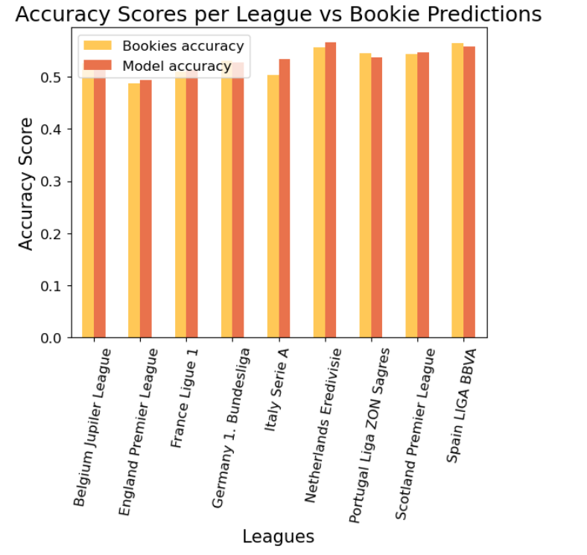
Conclusion
A model was built using FIFA statistics and engineered features to predict soccer match outcomes.
The accuracy of the model was evaluated using a test match dataset, and the Logistic Regression model had the highest accuracy score, followed by Random Forest and K-Nearest Neighbors models.
The model's accuracy was found to be higher than the bookies' accuracy by 47.76 basis points.
Overall, this suggests that the model may be a useful tool for predicting soccer match outcomes more accurately than traditional methods.

Slide 22
Thank You

